Slide 1
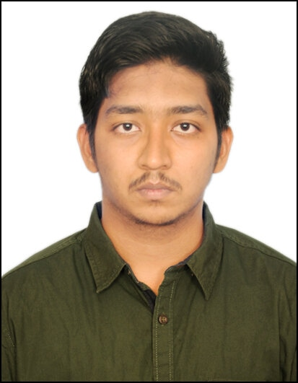
Shaik Aseff Hussain | Software Engineer
Name Shaik Aseff Hussain
Title Software Engineer - A5
Location Hyderabad, India
Professional Experience
Designing APIs with RAML
Mocking APIs to test the design and make APIs discoverable in Anypoint exchange.
Creating RESTful interfaces to API implementation
Deploying MuleSoft application in cloudHub and create API proxies in API Manager.
DataWeave expressions for basic XML, JSON and Java transformation and use DataWeave function, custom data types.
Basics of Handling errors
Familiar with REST based integration ,SQL queries, XML.
Familiar with processing records.
Technical Skills: Java, XML, RAML, SQL, Matlab, HTML, CSS, C++, C#.
Integration Tools: MuleSoft.
Certifications
MuleSoft Certified Developer - Level 1
Skills & Experience Summary
Shaik Aseff Hussain is a dedicated employee, graduated in May 2022 joined Capgemini in August 2022.
knowledgeable of developing API development and management using MuleSoft.
Competencies
Worked on MuleSoft-hosted Anypoint Platform to design, build, deploy, manage an API.
Build, debug and test API implementation and basic integrations with Anypoint Studio.
Implement fundamental transformations via DataWeave

